Slide 1
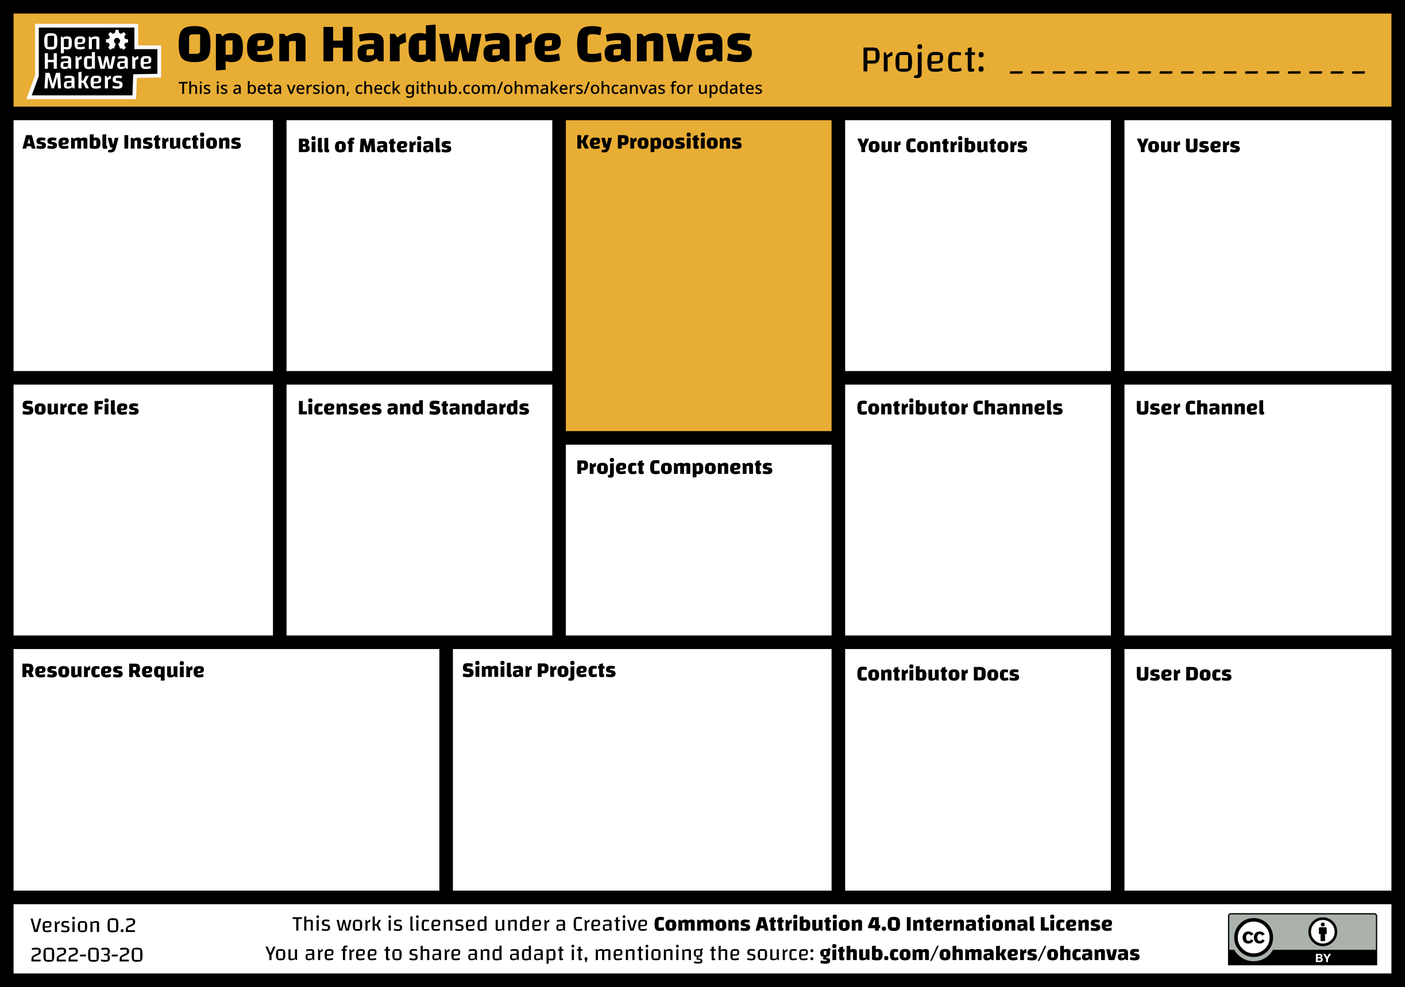
The Mini-Wind Tunnel Project
Assembly Instructions Required
These will consist of short “how-to” videos for each sub-section, in addition to documents and assembly drawings.
Laser cutting inc. material
£250
3D printing
£200
Off-the-Shelf Components
£1000
Aim is below £1.5K
Accurate costing is due soon
The flat pack mini-wind tunnel project seeks to inspire the next generation by bringing exciting, university-level experiments to the school classroom. Its open, modular design provides a low-cost foundation for educational institutes to further develop, and has the potential to be established as a legitimate research tool.
Universities, colleges, schools and industry. All have potential to create new experiments, modifications and design improvements.
Education - Schools, colleges, universities
Outreach - Universities & Industry
Research – Universities
Personal use - Hobbyists and industry
3D models supplied as STEP and STL files (universal format)
Drawings supplied as PDF and DXF (laser cutter compatible)
Educational Material supplied as documents (PDF) and follow-along videos (MP4/WMV).
Parts list
Supplied as PDF/XLS with hyperlinks to each shop.
Leaning towards a copyleft license
The project will be advertised through The University of Bath network and RS Component’s DesignSpark platform
https://www.rs-online.com/designspark/home
Contributors will be reached through project web page and DesignSpark platform
https://www.rs-online.com/designspark/home
Users will be reached through project web page, social media (Instagram, YouTube), and DesignSpark platform
https://www.rs-online.com/designspark/home
Design
Educational material
Data
Finance - tunnel is expected to cost between £1K to £1.5K. Work is ongoing to bring that figure down
Infrastructure - Access to 3D printers (FDM printers) and large laser cutters.
Skills – some electronics skills/tools is required to wire up fan. Tutorials will be given in assembly instructions.
Project Paperclip - Strength: A great low-cost wind tunnel build; Weakness: Low quality experiments
NASA repository – Strengths: NASA led designs; Weakness: No design files, custom, one-off-builds
Commercial Mini-Wind Tunnel – Strengths: High-quality, robust; Weakness: expensive, inflexible
Design files – drawings, CAD model, performance data.
Drawings, model files, assembly instructions and educational material.

